Slide 1
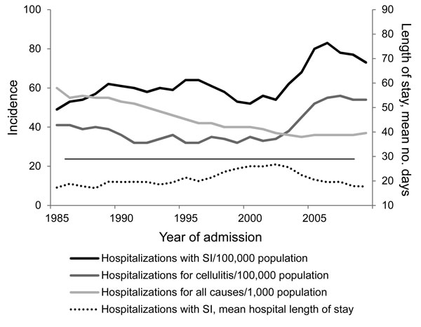
Figure 1
Figure 1. Hospitalization trends for children &lt;17 years of age, California, USA, 1985–2009. The incidence of hospitalizations and mean length of stay for children with staphylococcal infection (SI) are compared with the incidences of hospitalizations for cellulitis (Diagnosis Related Group [DRG] 279 or Medicare Severity–DRG 602–603) and for all-cause hospitalizations of children. The horizontal line separates the incidence graphs, which are to be read against the left axis, and the graph for length of stay, which is read against the right axis.
Gutierrez K, Halpern MS, Sarnquist C, Soni S, Arroyo A, Maldonado Y. Staphylococcal Infections in Children, California, USA, 1985–2009. Emerg Infect Dis. 2013;19(1):10-20. https://doi.org/10.3201/eid1901.111740

