Slide 1
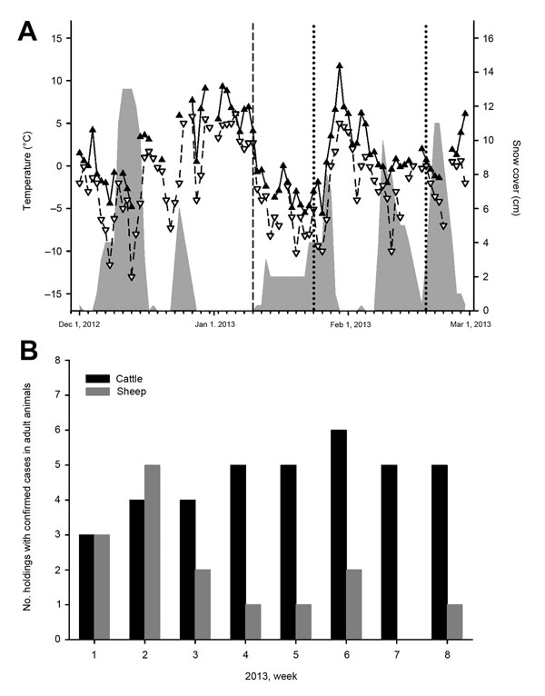
Figure
Figure. . Results of analysis of samples from sheep and cattle for Schmallenberg virus (SBV), Germany, 2012–2013. A) Climate data and sampling. The maximum temperatures are shown with filled triangles and a solid line and the minimum temperatures with unfilled triangles and a broken line. Snow cover is symbolized by a gray area. The dashed line represents the day of the detection of SBV genome in 4 sheep. Further sampling days are marked by dotted lines. B) PCR-confirmed Schmallenberg virus infections in adult cattle (black bars) or sheep (gray bars) in Germany during January 1–February 20, 2013.
Wernike K, Kohn M, Conraths FJ, Werner D, Kameke D, Hechinger S, et al. Transmission of Schmallenberg Virus during Winter, Germany. Emerg Infect Dis. 2013;19(10):1701-1703. https://doi.org/10.3201/eid1910.130622

