Slide 1
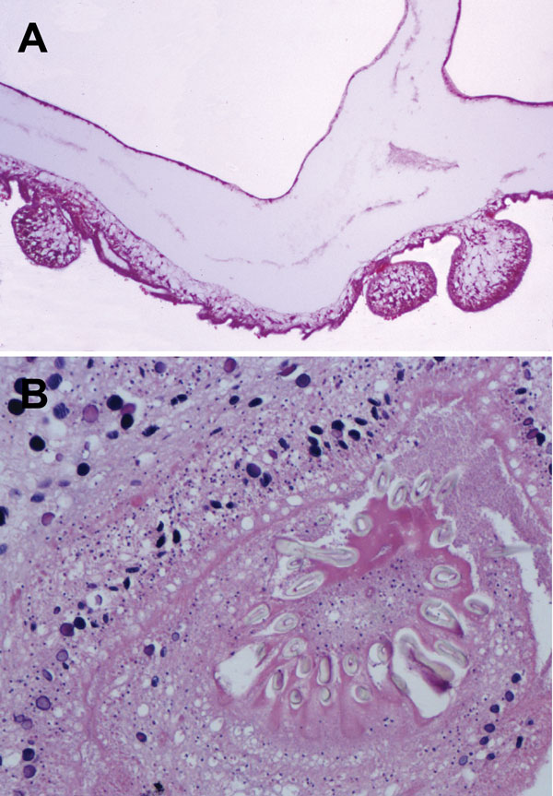
Figure 2
Figure 2. . Histologic section through Taenia crassiceps tapeworm larvae removed from the cerebellum of a 51-year-old woman, Germany. A) Section through parasite body showing multiple connected bladders (asexual buddings) at the caudal end. Original magnification ×20. B) Transverse section through the parasite’s protoscolex showing numerous hooklets, similar to T. solium tapeworm larvae. Original magnification ×40. Like the Taenia solium tapeworm that causes cysticercosis, and in contrast to different tapeworms that cause coenurosis (T. [Multiceps] multiceps, T. [Multiceps] serialis) or echinococcosis, the T. crassiceps tapeworm has only 1 invaginated protoscolex, but it is on a very long neck (Cysticercus longicollis). The hooklets of T. crassiceps tapeworms are larger than those of T. solium tapeworms and have a larger blade length than handle length. The small hooklets measure 123 µm; the large hooklets measure 167 µm.
Ntoukas V, Tappe D, Pfütze D, Simon M, Holzmann T. Cerebellar Cysticercosis Caused by Larval Taenia crassiceps Tapeworm in Immunocompetent Woman, Germany. Emerg Infect Dis. 2013;19(12):2008-2011. https://doi.org/10.3201/eid1912.130284

