Slide 1
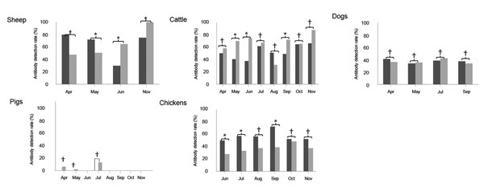
Figure 2
Figure 2. . . Serum antibody detection rate in domestic animals from Laizhou and Penglai counties, China, April–November 2011. Severe fever with thrombocytopenia syndrome virus N protein-specific antibodies were detected by double-antigen sandwich ELISA in serum samples of sheep, cattle, dogs, pigs, and chickens collected from Laizhou and Penglai counties in different months, and the antibody detection rates are presented. Black bars indicate samples from Laizhou; gray bars indicate samples from Penglai. The antibody detection rates in the 2 counties were compared (*p&lt;0.05, †p&gt;0.05).
Niu G, Li J, Liang M, Jiang X, Jiang M, Yin H, et al. Severe Fever with Thrombocytopenia Syndrome Virus among Domesticated Animals, China. Emerg Infect Dis. 2013;19(5):756-763. https://doi.org/10.3201/eid1905.120245

