Slide 1
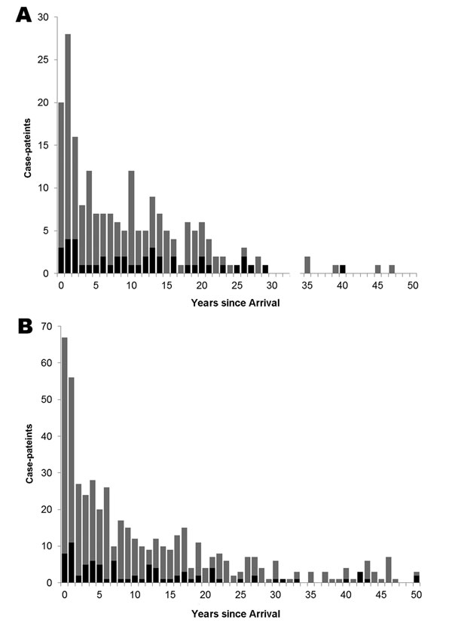
Figure
Figure. . . Number of clustered and nonclustered cases according to Mycobacterium tuberculosis lineage among foreign-born persons and time since arrival in Alberta, Canada, 1991–2007. A) Beijing cases; B) Non-Beijing cases. Gray bars, nonclustered cases; black bars, clustered cases.
Langlois-Klassen D, Senthilselvan A, Chui L, Kunimoto D, Saunders L, Menzies D, et al. Transmission of Mycobacterium tuberculosis Beijing Strains, Alberta, Canada, 1991–2007. Emerg Infect Dis. 2013;19(5):701-711. https://doi.org/10.3201/eid1905.121578

