Slide 1
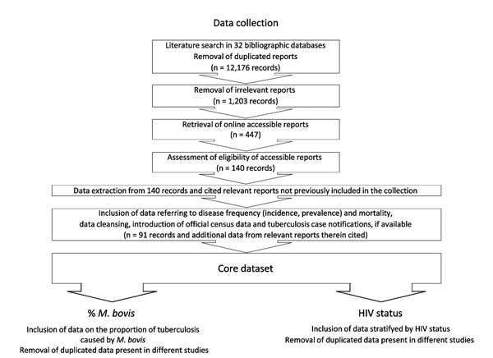
Figure 1
Figure 1. . Selection procedure for reports included in this analysis. A list of all identified 1,203 potentially relevant reports and the core dataset is available as supplemental material (Technical Appendix 2). TB, tuberculosis; M. bovis, Mycobacterium bovis.
Müller B, Dürr S, Alonso S, Hattendorf J, Laisse C, Parsons S, et al. Zoonotic Mycobacterium bovis–induced Tuberculosis in Humans. Emerg Infect Dis. 2013;19(6):899-908. https://doi.org/10.3201/eid1906.120543

