Slide 1
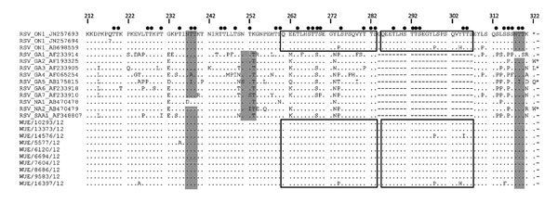
Figure
Figure. . . Amino acid sequence alignment of the second hypervariable region of the respiratory syncytial virus (RSV) G gene. RSV ON1 sequences and RSV A reference sequences in the upper part of the alignment are designated by GenBank numbers. ON1 sequences in the lower part were obtained in this study and are available at GenBank under accession nos. JX912355–JX912364. Black boxes indicate the duplicated region; black circles indicate potential O-glycosylation sites; and gray shading indicates potential N-glycosylation sites. Dots indicate nucleotide identities, dashes indicate adjustment of nucleotide insertions, and asterisks indicate stop codons. WUE, Würzburg.
Prifert C, Streng A, Krempl CD, Liese J, Weissbrich B. Novel Respiratory Syncytial Virus A Genotype, Germany, 2011–2012. Emerg Infect Dis. 2013;19(6):1029-1030. https://doi.org/10.3201/eid1906.121582

