Slide 1
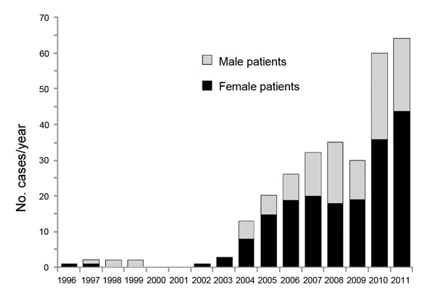
Figure 1
Figure 1. . Number of alveoloar echinococcosis cases reported in Kyrgyzstan, by patient sex, 1995–2011.
Usubalieva J, Minbaeva G, Ziadinov I, Deplazes P, Torgerson PR. Human Alveolar Echinococcosis in Kyrgyzstan. Emerg Infect Dis. 2013;19(7):1095-1097. https://doi.org/10.3201/eid1907.121405

