Slide 1
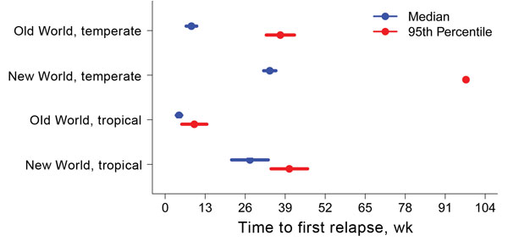
Figure 3
Figure 3. . . . . Predicted number of weeks from primary Plasmodium vivax malaria infection to first relapse, as determined by using flexible parametric survival models adjusted for neurologic treatment status, in a study quantifying the effect of geographic location on the epidemiology of the infection.
Lover AA, Coker RJ. Quantifying Effect of Geographic Location on Epidemiology of Plasmodium vivax Malaria. Emerg Infect Dis. 2013;19(7):1058-1065. https://doi.org/10.3201/eid1907.121674

