Slide 1
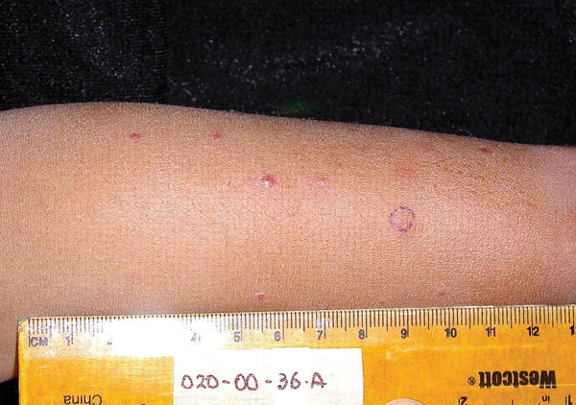
Figure 1
Figure 1. . Clinical presentation of verruga peruana in 3-year-old boy, Peru, 2003.
Blazes DL, Mullins K, Smoak BL, Jiang J, Canal E, Solorzano N, et al. Novel Bartonella Agent as Cause of Verruga Peruana. Emerg Infect Dis. 2013;19(7):1111-1114. https://doi.org/10.3201/eid1907.121718

