Slide 1
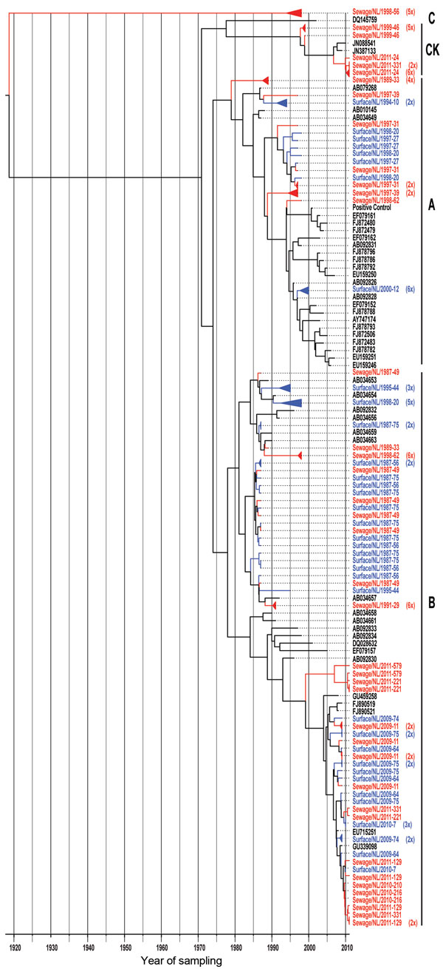
Figure 4
Figure 4. . . Maximum-clade credibility tree showing the phylogenetic relationships between Aichi virus isolates from the Netherlands and other locations, based on a multiple alignment of nucleotide sequences (139-nt) of the 3C region. The tree was generated by the Bayesian Markov chain Monte Carlo method in BEAST (28), rooted to the most recent common ancestor, visualized in FigTree (http://tree.bio.ed.ac.uk/software/figtree/), and plotted on a temporal y-axis scale using the sampling dates. Aichi virus strains from the Netherlands isolated from sewage (red) and surface waters (blue) are indicated; reference strains (black) are shown with GenBank accession numbers. Clusters of sequences of the same sample are represented by triangles (a collapsed branch), and the number of isolates in each triangle is shown between brackets. Aichi virus genotypes are shown on the right (A, B, and C). CK, canine kobuviruses.
Lodder WJ, Rutjes SA, Takumi K, Husman A. Aichi Virus in Sewage and Surface Water, the Netherlands. Emerg Infect Dis. 2013;19(8):1222-1230. https://doi.org/10.3201/eid1908.130312

