Slide 1
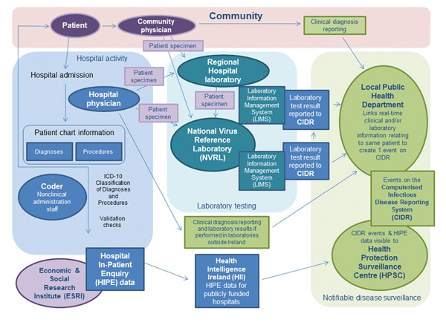
Figure 1
Figure 1. . Sources of information of clinical and laboratory diagnoses of notifiable infectious diseases in Ireland and the routes of reporting such diagnoses to the national Computerised Infectious Disease Reporting system.
Kelly TA, O’Lorcain P, Moran J, Garvey P, McKeown P, Connell J, et al. Underreporting of Viral Encephalitis and Viral Meningitis, Ireland, 2005–2008. Emerg Infect Dis. 2013;19(9):1428-1436. https://doi.org/10.3201/eid1909.130201

