Slide 1
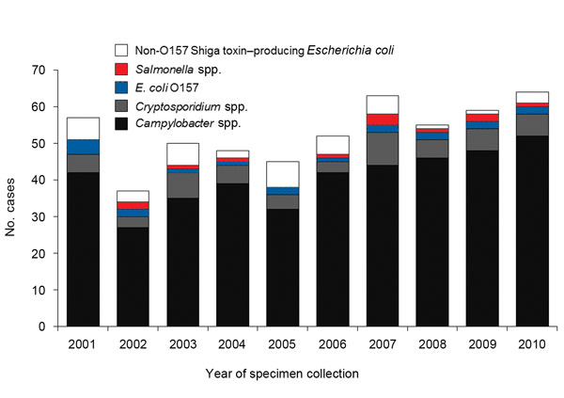
Figure 1
Figure 1. . Number of cases of domestically acquired, sporadic enteric infections for which the patient reported raw milk consumption, by year and pathogen (n = 530), Minnesota, 2001–2010.
Robinson TJ, Scheftel JM, Smith KE. Raw Milk Consumption among Patients with Non–Outbreak-related Enteric Infections, Minnesota, USA, 2001–2010. Emerg Infect Dis. 2014;20(1):38-44. https://doi.org/10.3201/eid2001.120920

