Slide 1
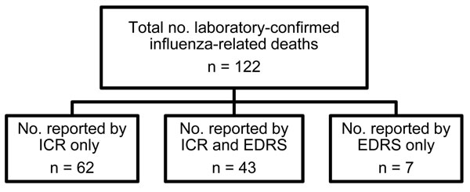
Figure 2
Figure 2. . Report source of laboratory-confirmed influenza-related deaths in Los Angeles County, California, USA, April 2009–April 2010. ICR, individual case report; EDRS, electronic death reporting system.
Bancroft EA, Lee S. Use of Electronic Death Certificates for Influenza Death Surveillance. Emerg Infect Dis. 2014;20(1):78-82. https://doi.org/10.3201/eid2001.130471

