Slide 1
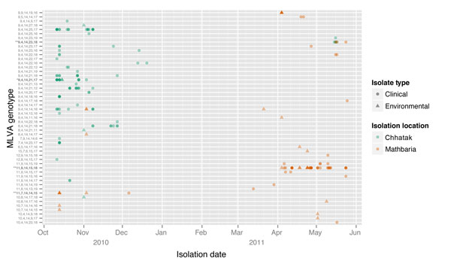
Figure 2
Figure 2. . Day of Vibrio cholerae isolation and genotype, Bangladesh, 2010–2011. Multiple genetically identical isolates on the same day increase the darkness of the shape. MLVA, multilocus variable tandem repeat analysis.
Rashed SM, Azman AS, Alam M, Li S, Sack DA, Morris J, et al. Genetic Variation of Vibrio cholerae during Outbreaks, Bangladesh, 2010–2011. Emerg Infect Dis. 2014;20(1):54-60. https://doi.org/10.3201/eid2001.130796

