Slide 1
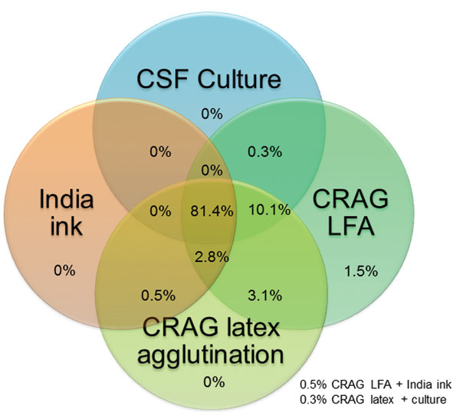
Figure 2
Figure 2. . Venn diagram of distribution of 393 cryptococcal meningitis cases tested by 4 diagnostic assays, Uganda and South Africa. CSF, cerebrospinal fluid; CRAG LFA, cryptococcal antigen lateral immunochromatographic flow assay; India ink, India ink microscopy of 1 mL of concentrated CSF specimen. Numbers at the bottom right indicate 2 scenarios in which the Venn diagram does not overlap visually.
Boulware DR, Rolfes MA, Rajasingham R, von Hohenberg M, Qin Z, Taseera K, et al. Multisite Validation of Cryptococcal Antigen Lateral Flow Assay and Quantification by Laser Thermal Contrast. Emerg Infect Dis. 2014;20(1):45-53. https://doi.org/10.3201/eid2001.130906

