Slide 1
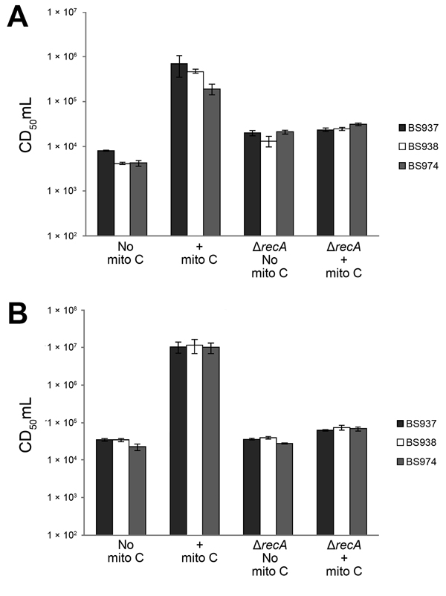
Figure 2
Figure 2. Mitomycin C induces production of Shiga toxin 1a (Stx1a) in a recA-dependent manner. Exponentially growing cultures of the indicated parental strains or recA mutants were grown with or without 0.5 μg/mL mitomycin C (mito C) for 3 hours. Supernatants (A) or whole cell lysates (B) were prepared for determination of cytotoxicity for Vero cells. CD50/mL values were determined as described in Figure 1. Data are averages of 3 biological replicates. Error bars indicate standard error. Δ indicates samples that are recA mutants.
Gray MD, Lampel KA, Strockbine NA, Fernandez RE, Melton-Celsa AR, Maurelli AT. Clinical Isolates of Shiga Toxin 1a–Producing Shigella flexneri with an Epidemiological Link to Recent Travel to Hispañiola. Emerg Infect Dis. 2014;20(10):1669-1677. https://doi.org/10.3201/eid2010.140292

