Slide 1
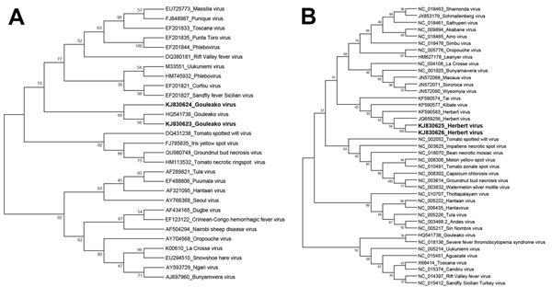
Figure 2
Figure 2. Phylogenetic analyses of Gouleako virus (GOLV) and Herbert virus (HEBV) collected from swine in the Republic of Korea, 2013 (KJ830623–J830626, in boldface), and other family Bunyaviridae viruses. The bootstrap consensus trees were constructed by using the maximum-likelihood method based on the general time-reversible model, implemented in MEGA version 6.06 (http://www.megasoftware.net). The phylogenetic trees for GOLV (A) and HEBV (B) were inferred on the basis of nucleotide sequences of the gene encoding nucleocapsid protein (GOLV) or RNA-dependent RNA polymerase (HEBV). The bootstrap values are shown next to the branches. Bunyaviridae virus sequences from previous studies (9,10) were used as reference sequences.
Chung H, Nguyen V, Goede D, Park C, Kim A, Moon H, et al. Gouleako and Herbert Viruses in Pigs, Republic of Korea, 2013. Emerg Infect Dis. 2014;20(12):2072-2075. https://doi.org/10.3201/eid2012.131742

