Slide 1
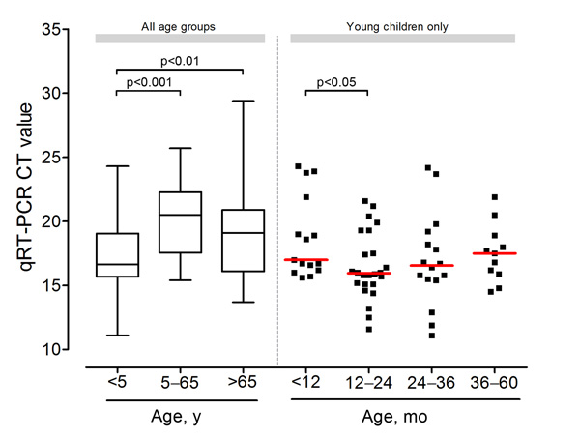
Figure 2
Figure 2. . Box-plot of fecal viral load of patients with norovirus strain of genogroup II, genotype 4 (GII.4 Sydney 2012) at hospital admission, Hong Kong, China, August 2012–July 2013. Horizontal lines indicate median values. Ct, cycle threshold; GII.4, genogroup II genotype 4; qRT-PCR, quantitative reverse transcription PCR.
Chan M, Leung TF, Kwok AK, Lee N, Chan P. Characteristics of Patients Infected with Norovirus GII.4 Sydney 2012, Hong Kong, China. Emerg Infect Dis. 2014;20(4):664-667. https://doi.org/10.3201/eid2004.131457

