Slide 1
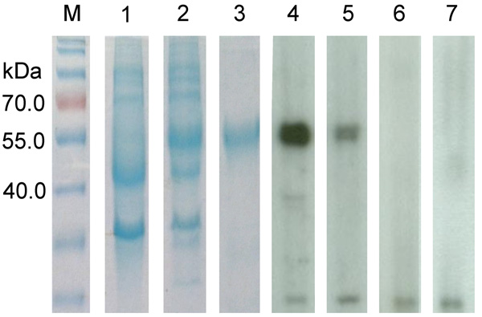
Figure 6
Figure 6. . . . . . Sodium dodecyl sulfate-polyacrylamide gel electrophoresis and Western blot analysis of a novel coronavirus, dromedary camel coronavirus UAE-HKU23, discovered in dromedaries of the Middle East, 2013.Nucleocapsid protein was expressed in Escherichia coli. M, protein molecular-mass marker; kDa, kilodaltons. Lanes: 1, non-induced crude E. coli cell lysate; 2, induced crude E. coli cell lysate of DcCoV UAE-HKU23 nucleocapsid protein; 3, purified recombinant DcCoV UAE-HKU23 nucleocapsid protein; 4, dromedary camel serum sample strongly positive for antibody against nucleocapsid protein; 5, dromedary camel serum sample moderately positive for antibody against nucleocapsid protein; 6 and 7: dromedary camel serum sample negative for antibody against nucleocapsid protein.
Woo P, Lau S, Wernery U, Wong E, Tsang A, Johnson B, et al. Novel Betacoronavirus in Dromedaries of the Middle East, 2013. Emerg Infect Dis. 2014;20(4):560-572. https://doi.org/10.3201/eid2004.131769

