Slide 1
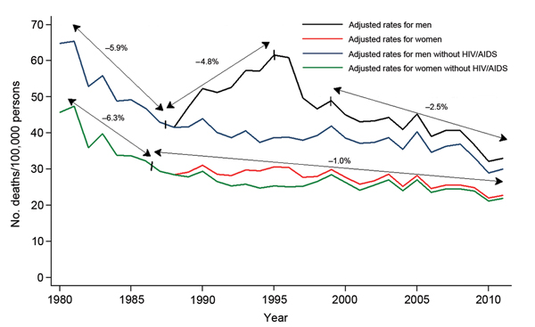
Figure 1
Figure 1. Infectious disease mortality rates by sex, Spain, 1980–2011.
López-Cuadrado T, Llácer A, Palmera-Suárez R, Gómez-Barroso D, Savulescu C, González-Yuste P, et al. Trends in Infectious Disease Mortality Rates, Spain, 1980–2011. Emerg Infect Dis. 2014;20(5):782-789. https://doi.org/10.3201/eid2005.131528

