Slide 1
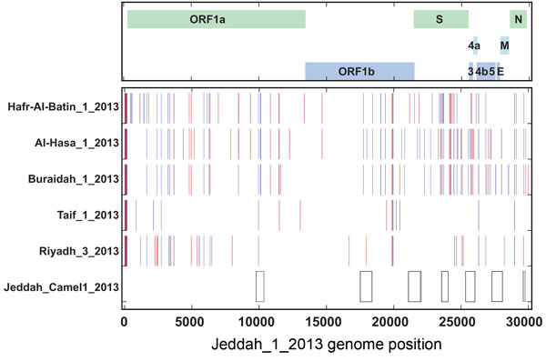
Figure
Figure. Direct comparison of the Middle East respiratory syndrome coronavirus (MERS-CoV) Jeddah_1_2013 genome sequence, Jeddah_ Camel1_2013 fragments (boxes at bottom), and representative genomes of other clade viruses: 2 additional genomes from the Riyadh_3 clade, Riyadh_3_2013 and Taif_1_2013; and representative genomes from the Al-Hasa and Hafr-Al-Batin_1 and Buraidah_1 cladesA map of the MERS-CoV genome with the major open reading frames (ORFs) indicated is shown at the topNucleotide differences for other genomes from Jeddah_1_2013 are shown by vertical colored bars: orange, change to A; red, change to T; blue, change to G; violet, change to CGaps in all full-genome sequences are indicated in grayPositions according to the MERS-CoV genome EMC/2012: fragment 1, 9767–10354; fragment 2, 17507–18394; fragment 3, 21089–22046; fragment 4, 23569–24059; fragment 5, 25349–26056; fragment 6, 27276–28095; fragment 7, 29596–29757The sequences reported here have been deposited in GenBank (accession nosKJ556337–KJ556340; others are pending).
Memish ZA, Cotten M, Meyer B, Watson SJ, Alsahafi AJ, Al Rabeeah AA, et al. Human Infection with MERS Coronavirus after Exposure to Infected Camels, Saudi Arabia, 2013. Emerg Infect Dis. 2014;20(6):1012-1015. https://doi.org/10.3201/eid2006.140402

