Slide 1
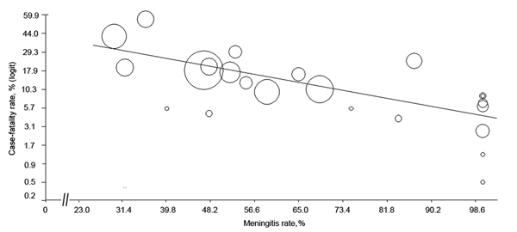
Figure 5
Figure 5. Meta-regression scatter plot showing the correlation between case-fatality rate and meningitis rate in a review of Streptococcus suis infectionThe logit event rate was calculated for case-fatality rate as follows: logit event rate = ln[event rate/(1 − event rate)]Each circle represents a study in the meta-analysis, and the size of the circle is proportional to study weightingStudies with higher meningitis rates tended to report lower death rates.
Huong V, Ha N, Huy N, Horby P, Nghia H, Thiem V, et al. Epidemiology, Clinical Manifestations, and Outcomes of Streptococcus suis Infection in Humans. Emerg Infect Dis. 2014;20(7):1105-1114. https://doi.org/10.3201/eid2007.131594

