Slide 1
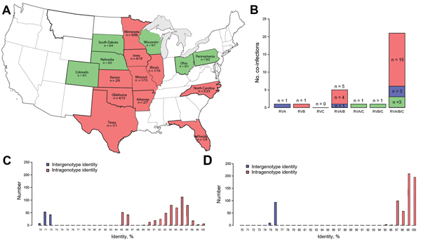
Figure 1
Figure 1. Epidemiologic and molecular distribution of porcine rotavirus H (RVH) strains, United States, 2006–2009A) Geographic distribution of RVH-positive porcine samples/total number of samples testedPink indicates states containing positive samples; green indicates states negative samples; white indicates states from which samples were not submittedB) Distribution of RVH-positive samples and age group in pigs co-infected with RVA, RVB, and/or RVCBlue indicates samples from the 4–20-day age group; pink indicates samples from the 21–55-day age group; green indicates samples from the &gt;55-day age groupC) RVH viral protein 6 nt pairwise identityD) RVH amino acid pairwise identity.
Marthaler D, Rossow K, Culhane M, Goyal S, Collins J, Matthijnssens J, et al. Widespread Rotavirus H in Commercially Raised Pigs, United States. Emerg Infect Dis. 2014;20(7):1203-1206. https://doi.org/10.3201/eid2007.140034

