Slide 1
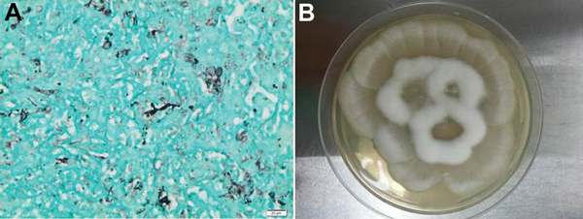
Figure
Figure. Histopathologic findings from a 34-year-old man with X-linked gp91phox gene mutation chronic granulomatous disease. A) Liver biopsy results showing numerous irregular and nonseptate hyphae with bulbous dilations. Gomori methenamine silver stain. Original magnification ×400. B) Culture of Mortierella wolfii, after 3-days of incubation at 30°C on Sabouraud agar medium.
Layios N, Canivet J, Baron F, Moutschen M, Hayette M. Mortierella wolfii–Associated Invasive Disease. Emerg Infect Dis. 2014;20(9):1591-1592. https://doi.org/10.3201/eid2009.140469

