Slide 1
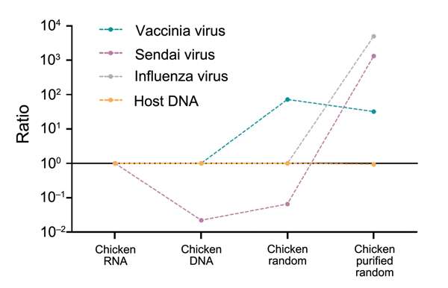
Figure 9
Figure 9. Changes in virus-to-host nucleic acid signal-to-noise ratio during development of tissue-based universal virus detection for viral metagenomics (TUViD-VM) protocol. Next-generation sequencing results for virus-infected chicken tissue comparatively sequenced were obtained by using 4 approaches: standard RNA library preparation (Chicken RNA), standard DNA library preparation (Chicken DNA), DNA library from random-amplified chicken tissue (Chicken random), and DNA library from random-amplified chicken tissue prepared by using TUViD-VM (Chicken purified random). The y-axis is log-scaled.
Kohl C, Brinkmann A, Dabrowski PW, Radonić A, Nitsche A, Kurth A. Protocol for Metagenomic Virus Detection in Clinical Specimens. Emerg Infect Dis. 2015;21(1):48-57. https://doi.org/10.3201/eid2101.140766

