Slide 1
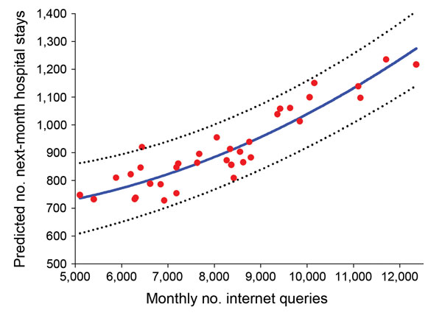
Figure 2
Figure 2. Relationship between the monthly number of Internet search queries for food poisoning and predicted number of inpatient hospital stays for total bacterial foodborne illness and infectious enteritis for next month by seasonal autoregressive integrated moving average model, South Korea, January 2010–December 2012. Red dots and blue line represent actual and predicted numbers of inpatient hospital stays, respectively. Dotted lines indicate 95% CIs (R2 = 0.71).
Bahk G, Kim Y, Park M. Use of Internet Search Queries to Enhance Surveillance of Foodborne Illness. Emerg Infect Dis. 2015;21(11):1906-1912. https://doi.org/10.3201/eid2111.141834

