Slide 1
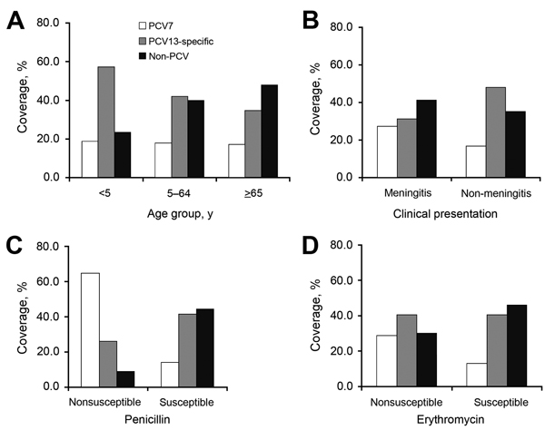
Figure 2
Figure 2. Invasive pneumococcal disease study variables and PCV coverage of Streptococcus pneumoniae serotypes, Europe, 2010. A) Age group. B) Clinical presentation. C) Penicillin susceptible. D) Erythromycin susceptible. For all 4 variables, p&lt;0.001. White bars, PCV7 serotypes; gray bars, PCV13 serotypes; black bars, non-PCV serotypes. PCV, pneumococcal conjugate vaccine; PCV7, 7-valent PCV; PCV13, 13-valent PCV.
Navarro-Torné A, Dias J, Hruba F, Lopalco P, Pastore-Celentano L, Gauci AJ. Risk Factors for Death from Invasive Pneumococcal Disease, Europe, 2010. Emerg Infect Dis. 2015;21(3):417-425. https://doi.org/10.3201/eid2103.140634

