Slide 1
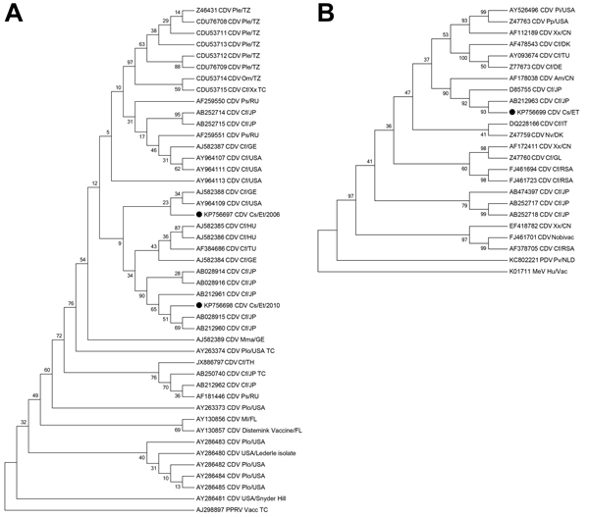
Figure 2
Figure 2. Phylogenetic neighbor-joining trees of canine distemper virus (CDV) isolates from samples collected during outbreaks in 2006 and 2011 (A) and 2010 (B). Evolutionary analyses were conducted in MEGA6 (30). A) Tree constructed using the phosphoprotein gene (331 nt). Evolutionary distances were computed using the Kimura 2-parameter method and are in the units of the number of base substitutions per site. The analysis involved 45 nt sequences and a total of 331 positions in the final dataset. B) Tree constructed by using the hemagglutinin gene (1,334 nt). Bootstrap values (10,000 replicates) are indicated at relevant nodes. Black dot indicates Ethiopian wolf samples. Species from which the viruses were isolated are indicated by the following abbreviations: Am, Ailuropoda melanoleuca (giant panda); Cf, Canis familiaris (dog); Cs, Canis simensis (Ethiopian wolf); Hu, human; Mma, Martes martes (European marten); Ml, Mustela lutreola (European mink); Mm, Meles meles (badger); Nv, Neovison vison (American mink); Om, Otocyon megalotis (bat-eared fox); Ple, Panthera leo (lion); Plo, Procyon lotor (raccoon); Pp, Panthera pardus (black leopard); Ps, Phoca sibirica (Baikal seal); Pv, Phoca vitulina (harbor seal); Xx, species unidentified. Country of sample origin are indicated as follows: CN, China; DK, Denmark; ET, Ethiopia; FL, Finland; GE, Germany; GL, Greenland; HU, Hungary; IT, Italy; JP, Japan; NLD, the Netherlands; RU, Russia; RSA, South Africa; TU, Turkey; TZ, Tanzania. TC denotes where isolates have undergone extensive tissue culture passage. Phylogenetic outgroups are indicated as follows: PPRV, peste des petits ruminants virus; PDV, phocine distemper virus; and MeV, measles virus.
Gordon CH, Banyard A, Hussein A, Laurenson M, Malcolm JR, Marino J, et al. Canine Distemper in Endangered Ethiopian Wolves. Emerg Infect Dis. 2015;21(5):824-832. https://doi.org/10.3201/eid2105.141920

