Slide 1
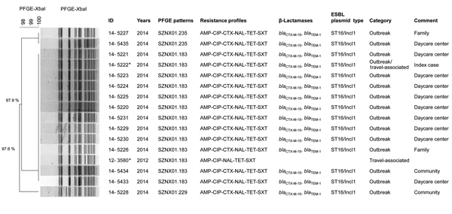
Figure 2
Figure 2. XbaI pulsed-field gel electrophoresis patterns of Shigella sonnei strains identified during a 2014 outbreak in South Korea and 2 isolated from samples from persons in Vietnam. The dendrogram was constructed by using Dice coefficient and UPGMA clustering, with 1.5% optimization and 1.5% position tolerance. Antibiotic resistance profiles and resistance determinants to extended-spectrum cephalosporins and fluoroquinolones are plotted next to the dendrogram. All strains had QRDR mutations GyrA(S83L,D87G) and ParC(S80I). *Strains 14-5222 and 12-3580 originated in Vietnam. AMP, ampicillin; CIP, ciprofloxacin; CTX, cefotaxime; NAL, nalidixic acid; TET, tetracycline; SXT, trimethoprim/sulfamethoxazole; QRDR, quinolone resistance–determining region. Scale bar indicates percentage relatedness.
Kim J, Kim J, Kim S, Jeon S, Seo K, Choi J, et al. Outbreak of Ciprofloxacin-Resistant Shigella sonnei Associated with Travel to Vietnam, Republic of Korea. Emerg Infect Dis. 2015;21(7):1247-1250. https://doi.org/10.3201/eid2107.150363

