Slide 1
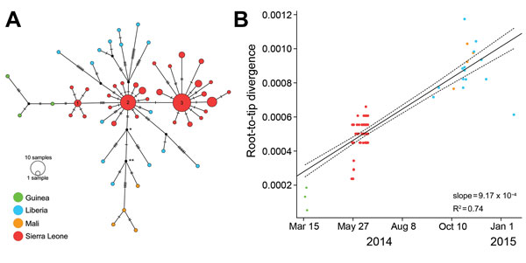
Figure 1
Figure 1. A) Median-joining haplotype network constructed from a full-genome alignment of 122 clinical Ebola virus Makona (EBOV/Mak) isolates (list of isolates in Technical Appendix 3). Each colored vertex represents a sampled viral haplotype, with the numbered vertices representing the centers of the 3 clusters described in (12). All sampled isolates from Liberia originated from cluster 2. The size of each vertex is relative to the number of sampled isolates, and the colors indicate country of origin. Hatch marks indicate the number of mutations along each edge. Because of missing data, 2,764 sites (14.6% of total genome) were excluded from the analysis, including 26 sites with variability among isolates (16.7% of all variable sites). B) Root-to-tip distance correlates well with test date and estimates a rate of evolution equal to 9.17 × 10−4 substitutions/site/year. This analysis comprises 110 clinical EBOV/Mak isolates collected during March 17, 2014–January 20, 2015 (Technical Appendix 3, isolates with dates).
Kugelman JR, Wiley MR, Mate S, Ladner JT, Beitzel B, Fakoli L, et al. Monitoring of Ebola Virus Makona Evolution through Establishment of Advanced Genomic Capability in Liberia. Emerg Infect Dis. 2015;21(7):1135-1143. https://doi.org/10.3201/eid2107.150522

