Slide 1
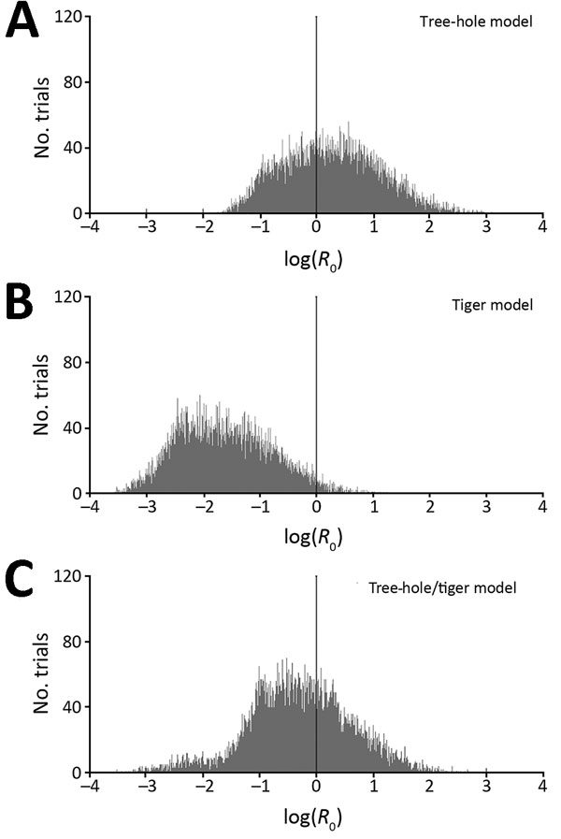
Figure 2
Figure 2. Histograms of basic reproduction numbers (R0) for La Crosse virus, based on Latin hypercube sampling analyses with 10,000 randomly selected parameter sets (ranges shown at http://www.clfs.umd.edu/biology/faganlab/disease-ecology.html). A) Tree-hole model, B) tiger model, and C) tree-hole and tiger model. In each panel, the black vertical line at log(R0) = 0 corresponds to the general breakpoint between growing and shrinking infection rates and thus represents the threshold for La Crosse virus disease persistence.
Bewick S, Agusto F, Calabrese JM, Muturi EJ, Fagan WF. Epidemiology of La Crosse Virus Emergence, Appalachia Region, United States. Emerg Infect Dis. 2016;22(11):1921-1929. https://doi.org/10.3201/eid2211.160308

