Slide 1
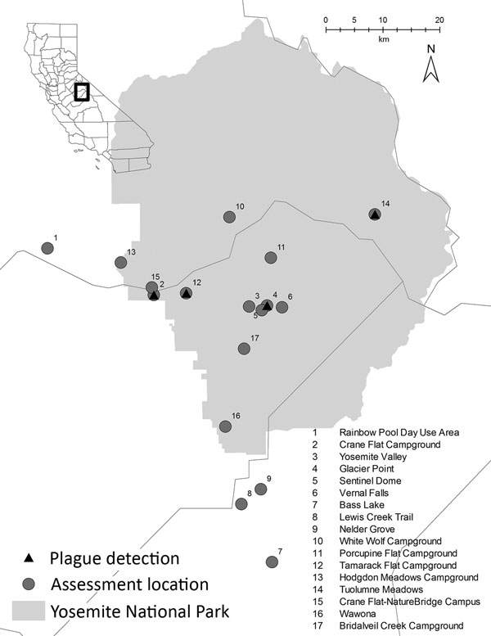
Figure 1
Figure 1. Locations of plague transmission risk assessments in and around Yosemite National Park, California, USA, August–October 2015.
Danforth M, Novak M, Petersen J, Mead PS, Kingry L, Weinburke M, et al. Investigation of and Response to 2 Plague Cases, Yosemite National Park, California, USA, 2015. Emerg Infect Dis. 2016;22(12):2045-2053. https://doi.org/10.3201/eid2212.160560

