Slide 1
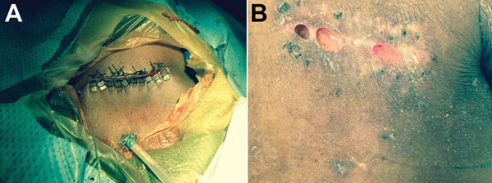
Figure
Figure. Photographs of the cardiac implantable electronic device pocket site for a 60-year-old man in whom infection developed at the implantation site of a cardiac implantable electronic device, Atlanta, Georgia, USA. A) Device pocket site after explantation. The wound was closed with pledged Ethibond sutures (Ethicon, Somerville, NJ, USA), and a Jackson-Pratt drain (closed-suction drainage system consisting of an internal drain connected by plastic tubing to a flexible bulb) was tunneled into the inferior aspect of the pocket. The drain was removed 24 hours postoperatively, and a small incision was left open to heal by secondary intention. B) Device pocket site 6 weeks after suture removal. Most of the incision healed well, with evidence of localized dehiscence (i.e., spontaneous partial separation of the surgical incision along the suture lines).
Phadke VK, Hirsh DS, Goswami ND. Patient Report and Review of Rapidly Growing Mycobacterial Infection after Cardiac Device Implantation. Emerg Infect Dis. 2016;22(3):389-395. https://doi.org/10.3201/eid2203.150584

