Slide 1
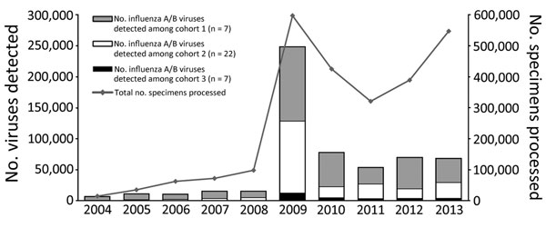
Figure 1
Figure 1. Changes in numbers of influenza specimens processed and in numbers of viruses detected per year among 35 countries that partnered with the Centers for Disease Control and Prevention to strengthen influenza surveillance capacity, 2004–2013. From a total of 39 participating countries, 35 responded to a 2013 questionnaire and are included in this analysis.
Polansky LS, Outin-Blenman S, Moen AC. Improved Global Capacity for Influenza Surveillance. Emerg Infect Dis. 2016;22(6):993-1001. https://doi.org/10.3201/eid2206.151521

