Slide 1
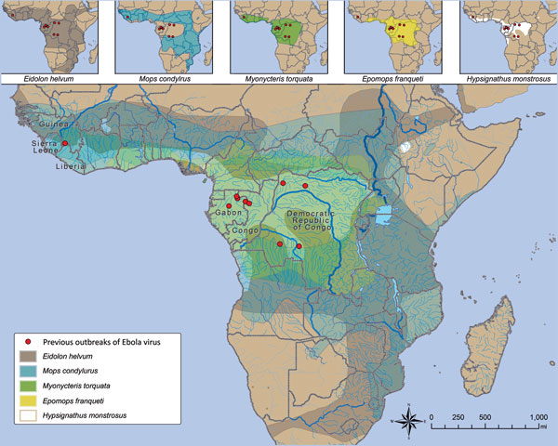
Figure 2
Figure 2. Relationship between location of index case in Ebola virus (Zaire ebolavirus) outbreaks and putative reservoir distribution. Ebola virus outbreaks (red dots) and distribution of Eidolon helvum, Mops condylurus, Myonycteris torquata, Epomops franqueti, and Hypsignathus monstrosus bats (insets) are shown. Data are from the Centers for Disease Control and Prevention and the International Union for the Conservation of Nature.
Spengler JR, Ervin E, Towner JS, Rollin PE, Nichol ST. Perspectives on West Africa Ebola Virus Disease Outbreak, 2013–2016. Emerg Infect Dis. 2016;22(6):956-963. https://doi.org/10.3201/eid2206.160021

