Slide 1
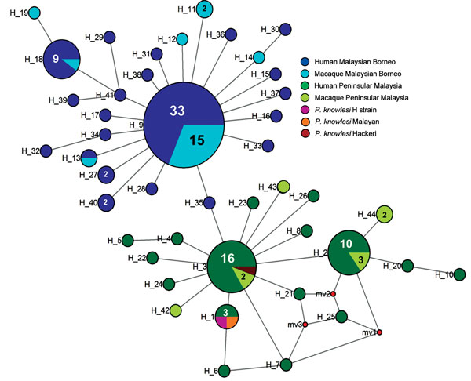
Figure 3
Figure 3. Median-joining networks of Plasmodium knowlesi cytochrome oxidase subunit I haplotypes from Malaysia. The genealogical haplotype network shows the relationships among the 44 haplotypes present in the 138 sequences obtained from human and macaque samples from Peninsular Malaysia and Malaysian Borneo. Each distinct haplotype has been designated a number (H_n). Circle sizes represents the frequencies of the corresponding haplotype (the number is indicated for those that were observed more than once). Small red nodes are hypothetical median vectors created by the program to connect sampled haplotypes into a parsimonious network. Distances between nodes are arbitrary.
Yusof R, Ahmed M, Jelip J, Ngian H, Mustakim S, Hussin H, et al. Phylogeographic Evidence for 2 Genetically Distinct Zoonotic Plasmodium knowlesi Parasites, Malaysia. Emerg Infect Dis. 2016;22(8):1371-1380. https://doi.org/10.3201/eid2208.151885

