Slide 1
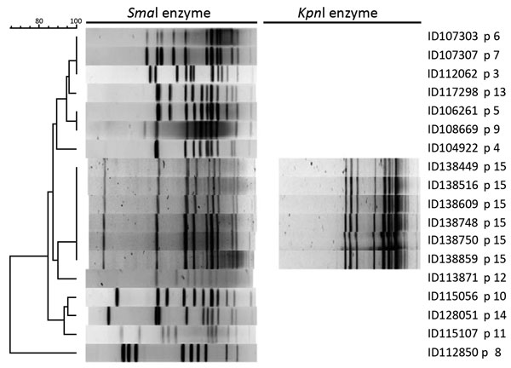
Figure
Figure. Pulsed-field gel electrophoresis patterns of Campylobacter coli with SmaI (18 isolates) and KpnI (6 isolates) enzymes tested in study of C. coli outbreak among 6 men in Quebec, Canada, 2011–2015. p, pulsovar. Scale bar indicates percentage similarity.
Gaudreau C, Pilon PA, Sylvestre J, Boucher F, Bekal S. Multidrug-Resistant Campylobacter coli in Men Who Have Sex with Men, Quebec, Canada, 2015. Emerg Infect Dis. 2016;22(9):1661-1663. https://doi.org/10.3201/eid2209.151695

