Slide 1
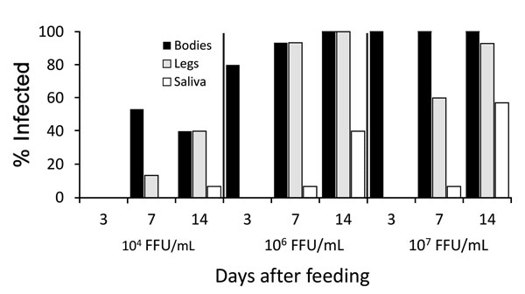
Figure 4
Figure 4. Infection, dissemination, and transmission of the Zika virus strain FSS 13025 by Aedes aegypti mosquitoes from Salvador, Brazil, after blood meals from infected A129 mice with viremic titers of 4 log10, 6 log10, or 7 log10 focus-forming units/mL.
Roundy CM, Azar SR, Rossi SL, Huang JH, Leal G, Yun R, et al. Variation in Aedes aegypti Mosquito Competence for Zika Virus Transmission. Emerg Infect Dis. 2017;23(4):625-632. https://doi.org/10.3201/eid2304.161484

