Slide 1
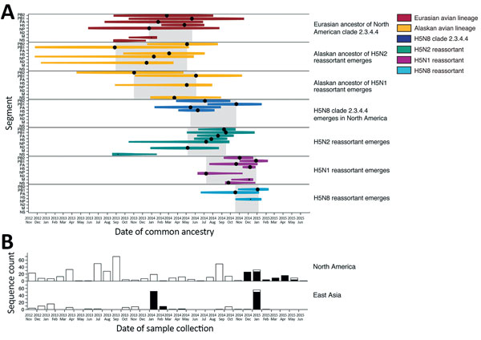
Figure 1
Figure 1. Molecular dating of the emergence of H5 clade 2.3.4.4 influenza A virus in Eurasia and North America and concurrent trends in surveillance effort. A) Events contributing to the evolution of H5 clade 2.3.4.4 estimated using multiple influenza segments. Time of most recent common ancestry (indicated by a black circle) is size-scaled by the posterior probability (0.0–1.0), and the 95% highest posterior density is color-coded by lineage. Gray shading indicates time of most recent common ancestry of multiple segments with a posterior probability &gt;0.85. B) Surveillance effort estimated by the number of hemagglutinin sequences (high and low pathogenicity) available in the Influenza Research Database (https://www.fludb.org). Black bars indicate surveillance effort for H5 clade 2.3.4.4; white bars indicate surveillance effort for other clades. M, matrix gene; N2, neuraminidase 2 gene; NP, nucleoprotein gene; PA, polymerase acidic, PB1, basic polymerase protein 1 gene; PB2, basic polymerase protein 2 gene; tMRCA, time of most recent common ancestry.
Hill NJ, Hussein I, Davis KR, Ma EJ, Spivey TJ, Ramey AM, et al. Reassortment of Influenza A Viruses in Wild Birds in Alaska before H5 Clade 2.3.4.4 Outbreaks. Emerg Infect Dis. 2017;23(4):654-657. https://doi.org/10.3201/eid2304.161668

