Slide 1
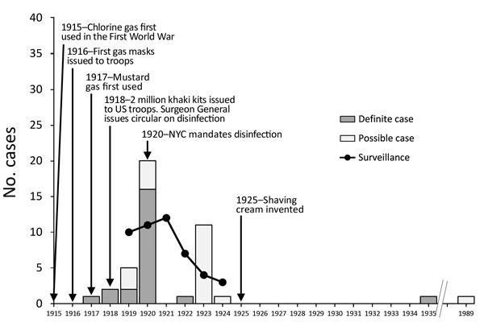
Figure
Figure. Timeline of use of shaving brushes and anthrax, 1915—1989. Case totals for the United States were reported in 1924 and 1930 and included 2 cases for 1927 through mid-1929, but the exact year of occurrence was unspecified (5,6). Data for English-language case descriptions were obtained from a systematic review of systemic anthrax cases published during 1880–2013 (7). Individual cases were reported from the United States, with the following exceptions: 1917, 1 definite case from England; 1918, 2 definite cases from Canada; 1920, 1 definite case from England; 1924, 1 possible case from South Africa; 1935, 1 definite case from Trinidad (8); and 1989, 1 possible case from India (9).
Szablewski CM, Hendricks K, Bower WA, Shadomy S, Hupert N. Anthrax Cases Associated with Animal-Hair Shaving Brushes. Emerg Infect Dis. 2017;23(5):806-808. https://doi.org/10.3201/eid2305.161554

