Slide 1
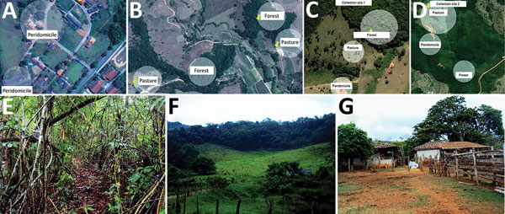
Figure 2
Figure 2. Location of collection sites and biomes represented in each, Minas Gerais state, Brazil. A) Collection site 1 in Serro. B) Collection site 2 in Serro. C) Peridomicile collection areas in Rio Pomba. D) Forest and pasture collection areas in Rio Pomba. E) Example of a forest area where animals were captured. F) Example of peridomicile area. G) Example of pasture area. In panels A–D, circles represent areas where transects for capture were demarcated. Sources: panels A,–D, Google Maps, modified by F.V. Nunes; panels E–G, F.V. Nunes.
Miranda JB, Borges IA, Campos S, Vieira FN, de Ázara T, Marques FA, et al. Serologic and Molecular Evidence of Vaccinia Virus Circulation among Small Mammals from Different Biomes, Brazil. Emerg Infect Dis. 2017;23(6):931-938. https://doi.org/10.3201/eid2306.161643

