Slide 1
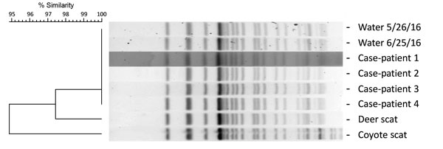
Figure
Figure. Pulsed-field gel electrophoresis (PFGE) analysis of Shiga toxin 1– and 2–producing Escherichia coli O157 isolates digested with XbaI. A dendrogram displaying PFGE pattern similarity is shown at left. The PFGE profiles for the case-patients and water isolates were identical and designated as pattern EXH01.0238 by PulseNet (https://www.cdc.gov/pulsenet/). The PFGE patterns for the deer and coyote scat isolates shared &gt;95% similarity with pattern EXH01.0238. Dates on water samples indicate date of collection.
Probert WS, Miller GM, Ledin KE. Contaminated Stream Water as Source for Escherichia coli O157 Illness in Children. Emerg Infect Dis. 2017;23(7):1216-1218. https://doi.org/10.3201/eid2307.170226

