Slide 1
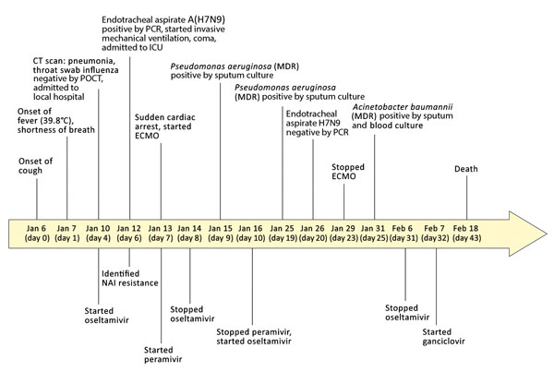
Figure 1
Figure 1. Clinical course of 56-year-old man with diabetes and hypertension infected with highly pathogenic avian influenza A(H7N9) virus, China, 2017. CT, computed tomography; ECMO, extracorporeal membrane oxygenation; ICU, intensive care unit; MDR, multidrug resistant; NAI, neuraminidase inhibitor; POCT, point-of-care test.
Ke C, Mok C, Zhu W, Zhou H, He J, Guan W, et al. Human Infection with Highly Pathogenic Avian Influenza A(H7N9) Virus, China. Emerg Infect Dis. 2017;23(8):1332-1340. https://doi.org/10.3201/eid2308.170600

