Slide 1
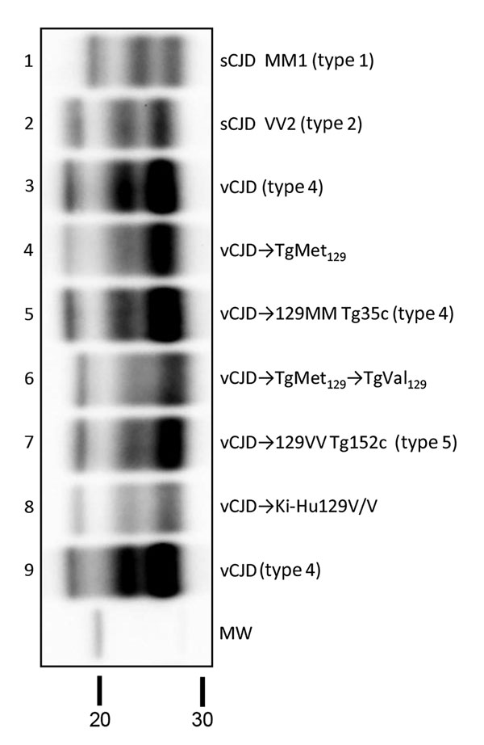
Figure 3
Figure 3. Biochemical comparison of brain protease-resistant prion protein (PrPres) detected in transgenic mice expressing prion protein Met129, and Val129 mice and inoculated with vCJD brain homogenate. Similar quantities of PrPres were loaded for adequate comparison, and immunoblots were detected by using Sha31 monoclonal antibody. Lanes 4 and 6 show passages from this study; lane 5 shows sample codification I-10629 and lane 7 sample codification I-11724 from the MRC Prion Unit in the United Kingdom (27); lane 8 shows sample codification #139-A5603 from Tohoku University Graduate School of Medicine, Sendai, Japan (30). The original vCJD isolate (Hu-vCJD2) used for mouse inoculations in this study was also included on the blot (lanes 3 and 9); sCJD MM1 (lane 1) and VV2 (lane 2) isolates were included for biochemical comparative purposes. Molecular weight (MW) in kDa is shown. CJD, Creutzfeldt-Jakob disease; sCJD, sporadic CJD; vCJD, variant CJD.
Fernández-Borges N, Espinosa J, Marín-Moreno A, Aguilar-Calvo P, Asante EA, Kitamoto T, et al. Protective Effect of Val129-PrP against Bovine Spongiform Encephalopathy but not Variant Creutzfeldt-Jakob Disease. Emerg Infect Dis. 2017;23(9):1522-1530. https://doi.org/10.3201/eid2309.161948

