Slide 1
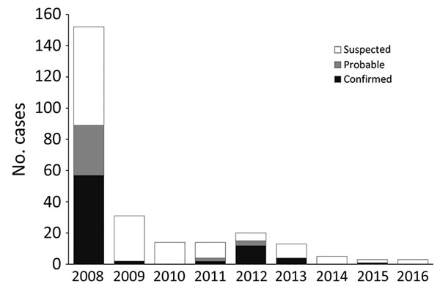
Figure 1
Figure 1. Suspected, probable, and confirmed human plague cases, by year, West Nile region, Uganda, 2008–2016.
Forrester JD, Apangu T, Griffith K, Acayo S, Yockey B, Kaggwa J, et al. Patterns of Human Plague in Uganda, 2008–2016. Emerg Infect Dis. 2017;23(9):1517-1521. https://doi.org/10.3201/eid2309.170789

