Slide 1
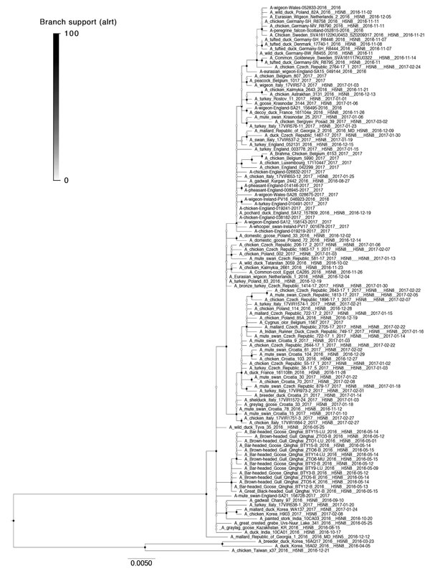
Figure 6
Figure 6. Maximum-likelihood tree from viral sequences of the 2016–17 highly pathogenic avian influenza H5 epizootic in Europe. Circles represent node support values, filled according to approximate likelihood ratio test values 0–100. Light gray boxes indicate distinct clades with support &gt;50 with isolates from Europe; dark gray boxes indicate clades with &lt;50 or unresolved. Scale bar indicates nucleotide substitutions per site. An expanded figure showing trees for all 3 epizootic years is available online (https://wwwnc.cdc.gov/EID/article/24/12/17-1860-F6.htm).
Alarcon P, Brouwer A, Venkatesh D, Duncan D, Dovas CI, Georgiades G, et al. Comparison of 2016–17 and Previous Epizootics of Highly Pathogenic Avian Influenza H5 Guangdong Lineage in Europe. Emerg Infect Dis. 2018;24(12):2270-2283. https://doi.org/10.3201/eid2412.171860

