Slide 1
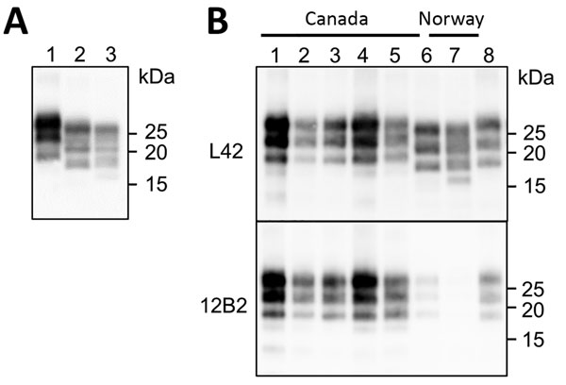
Figure 2
Figure 2. Western blot analysis of PrPres in brains of chronic wasting disease–affected cervids from Norway and Canada. A) Western blot analysis PrPres in brains of moose and reindeer from Norway. Membrane was probed with L42 monoclonal antibodies. Molecular weights (kDa) are indicated on the right. Tissue equivalent loaded per lane was 1 mg. B) Western blot analysis of PrPres from moose isolates from Norway (lanes 6–7) compared with PrPres from chronic wasting disease–affected elk or wapiti (lanes 1–3), white-tailed deer (lane 4), and moose (lane 5) from Canada. Membranes were probed with L42 (upper) and 12B2 (lower) monoclonal antibodies. A scrapie sheep sample from Italy was added as control (lane 8). Molecular weights (kDa) are indicated on the right of each blot. Tissue equivalents loaded per lane were 1 mg for Canadian isolates, 2 mg for Norwegian isolates, and 0.15 mg for scrapie sheep control. PrPres, protease-resistant core of abnormal form of prion protein.
Pirisinu L, Tran L, Chiappini B, Vanni I, Di Bari MA, Vaccari G, et al. Novel Type of Chronic Wasting Disease Detected in Moose (Alces alces), Norway. Emerg Infect Dis. 2018;24(12):2210-2218. https://doi.org/10.3201/eid2412.180702

