Slide 1
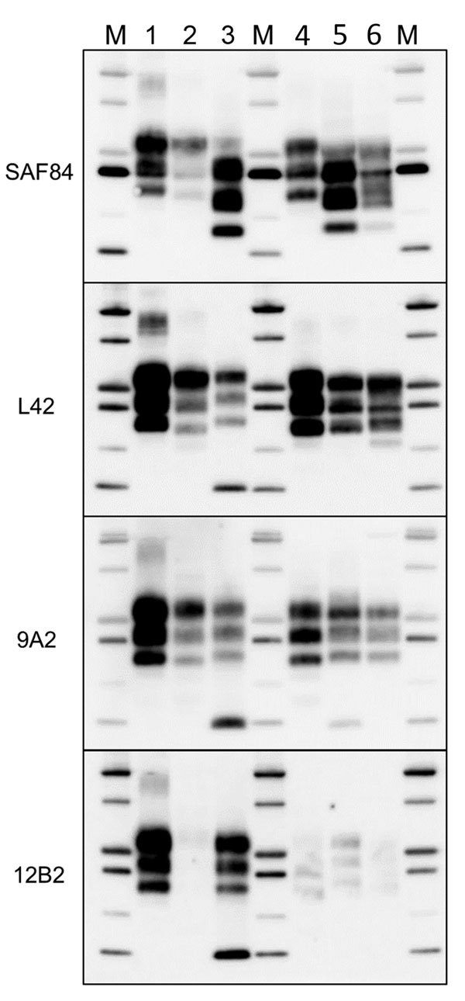
Figure 6
Figure 6. Comparison of protease-resistant core of abnormal form of prion protein from moose (Alces alces) in Europe with chronic wasting disease and from cattle with BSE. Representative blots show epitope mapping analysis of protease-resistant core of abnormal form of prion protein in moose (lane 5, moose no. 1; lane 6, moose no. 2) in comparison with different BSE isolates (lane 2, classical BSE; lane 3, H-type BSE; and lane 4, L-type BSE). A sheep scrapie isolate was loaded as control (lane 1). The antibodies are indicated on the left. Protein standards are shown in lane M (10, 15, 20, 25, 37, and 50 kDa). BSE, bovine spongiform encephalopathy.
Pirisinu L, Tran L, Chiappini B, Vanni I, Di Bari MA, Vaccari G, et al. Novel Type of Chronic Wasting Disease Detected in Moose (Alces alces), Norway. Emerg Infect Dis. 2018;24(12):2210-2218. https://doi.org/10.3201/eid2412.180702

