Slide 1
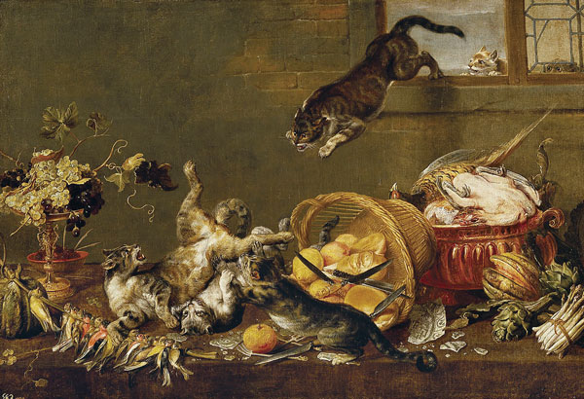
Figure
Figure. Paul de Vos, Cats Fighting in a Larder 1630–1640. Oil on canvas. Museo Nacional del Prado. https://www.museodelprado.es/coleccion/galeria-on-line/galeria-on-line/obra/pelea-de-gatos-en-una-despensa/, Public Domain, https://commons.wikimedia.org/w/index.php?curid=39117357
Henry R. Etymologia: Capnocytophaga canimorsus. Emerg Infect Dis. 2018;24(12):2201. https://doi.org/10.3201/eid2412.et2412

